Slide 1

Indoor Localization Robot

Slide 2
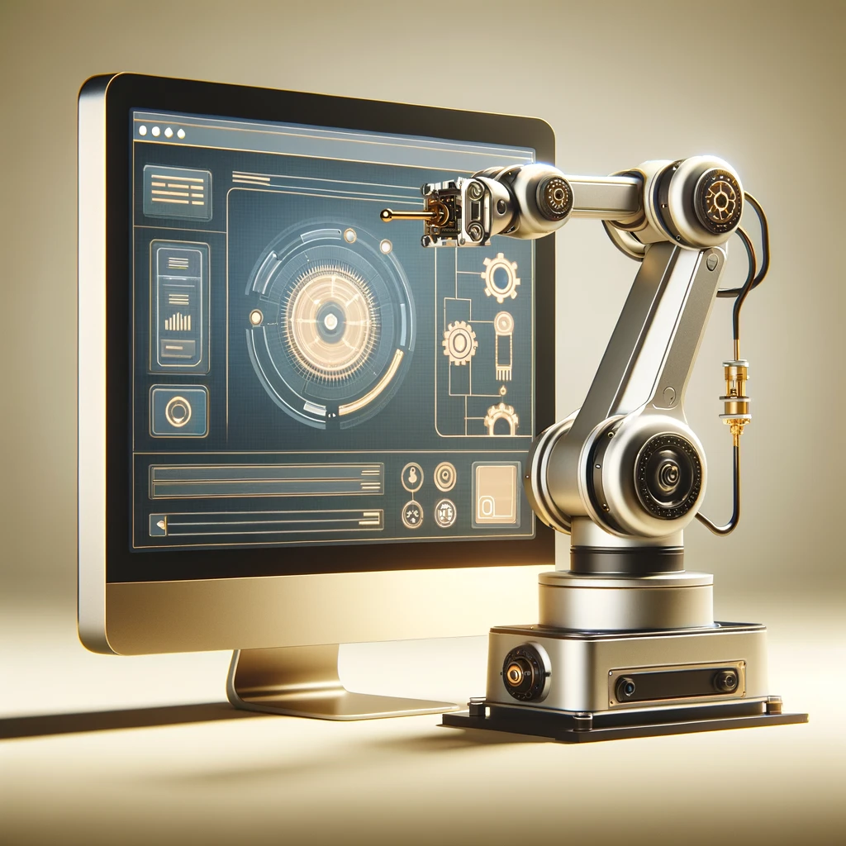
Main Purpose:
Managing and controlling robotic tasks through an intuitive web interface.

Slide 3
Structure:
Seamless interaction with robot and monitor performance.
Front-end
A robust architecture, integrating databases and server-side logic to handle real-time communication.
Back-end
Server
Running the dashboard and send data reliably to the robot using ROS scripts.

Slide 4





Technology Stack:

Slide 5
Main Features:
Flexibility in Adding Robots.
Creating Maps/Paths.
Creating and assigning tasks to robots.
Control robots with real-time data visualization.

Slide 6

Guiding principles
Vision
Mission
To be able to provide a solid hardware infrastructure with relative ease.
In the end of the project, the infrastructure is designed to be:
Sourced locally.
Modular.
Open-Source.

Slide 7
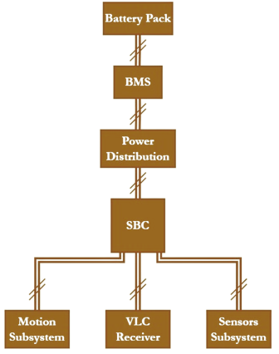
Robot Infra-structure:

Slide 8
Power Board:
Multiple Outputs for Power Distribution.
5V conversion, for powering the used SBC.
Reverse Polarity and Overcurrent Protection.

Slide 9
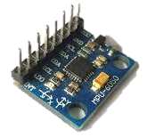
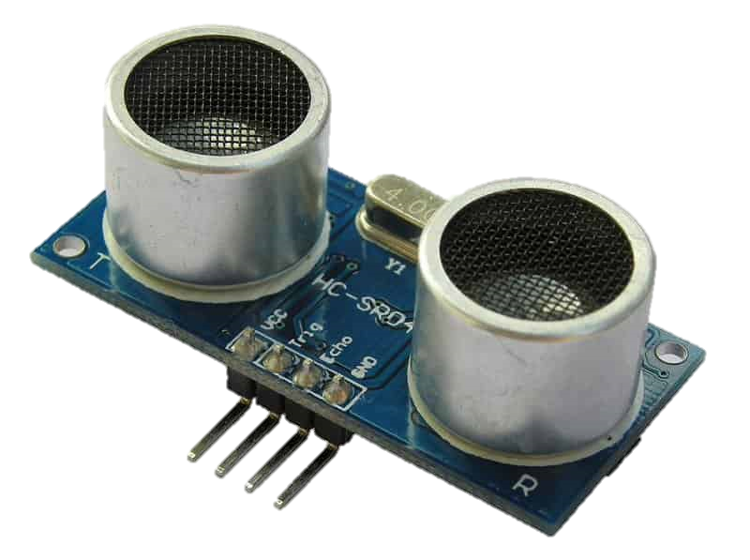
Sensors’ Board:
IMU : MPU6050
Ultrasonic sensor

Slide 10
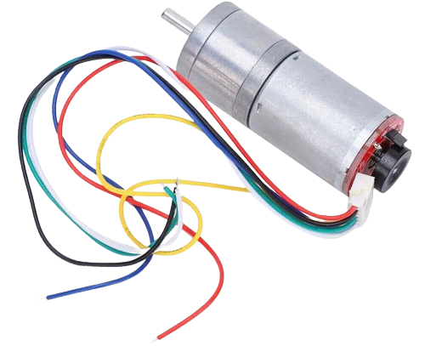
Motion Board:
DC motor

Slide 11
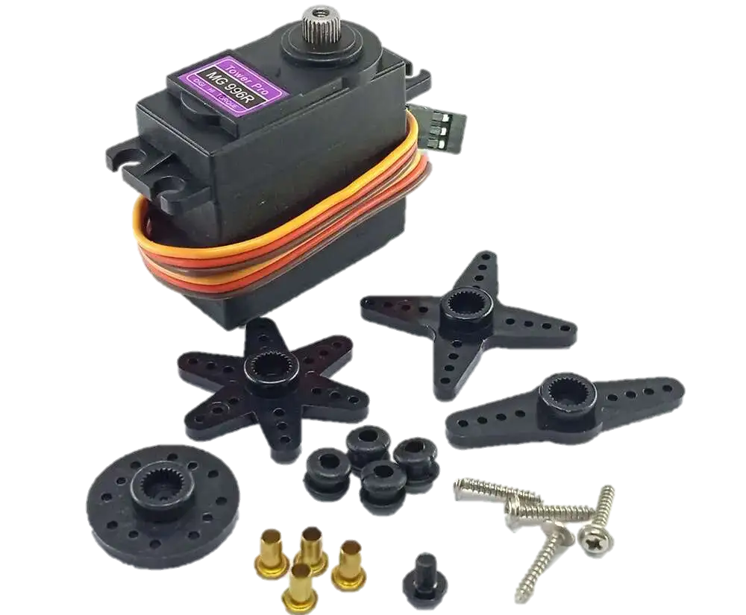
Actuators’ Board:
Servo Motor

Slide 12
Battery Management System:
Protection Features:
Monitoring Features:
Overvoltage
Undervoltage
Overcurrent
Short Circuit.
Voltage of each module.
Total Current of the pack
Temperature.

Slide 13
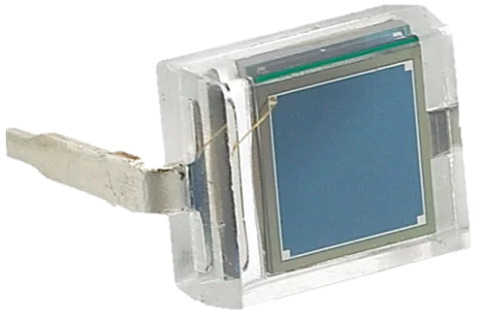
VLC [Transmitter and Receiver]:
A code is assigned to each region.
Controlled by a 220VAC LED
Each Bit corresponds to a certain intensity to be detected by the receiver.
BPW34 Micro solar cell for Detection

Slide 14
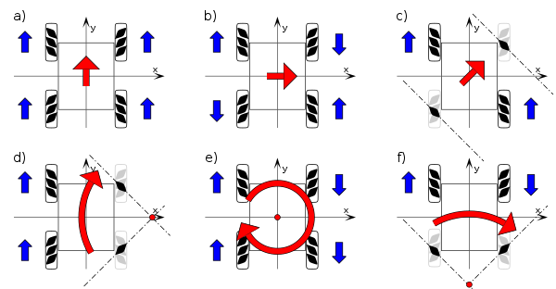
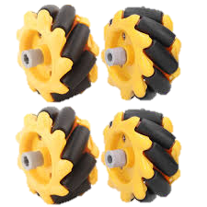
Meccanum Wheels:
Enable omnidirectional movement that allows the robot to move in any direction.

Slide 15
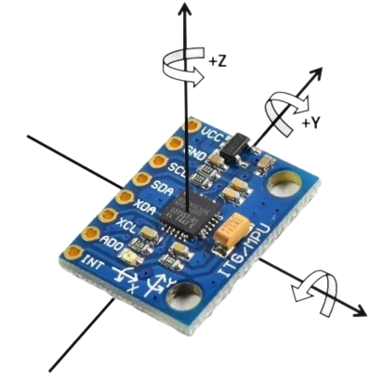
Sensors’ Board:
IMU : MPU6050
Ultrasonic sensor

Slide 16
ROS communication between robot and server:
Sensors Board
Motors Board

Slide 17
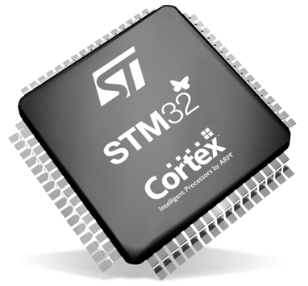
STM32 Microcontroller:
Purpose:
Key Benefit:
Designed for high-performance yet low-cost applications.
Balances performance and cost for diverse device integration.

